Slide 2
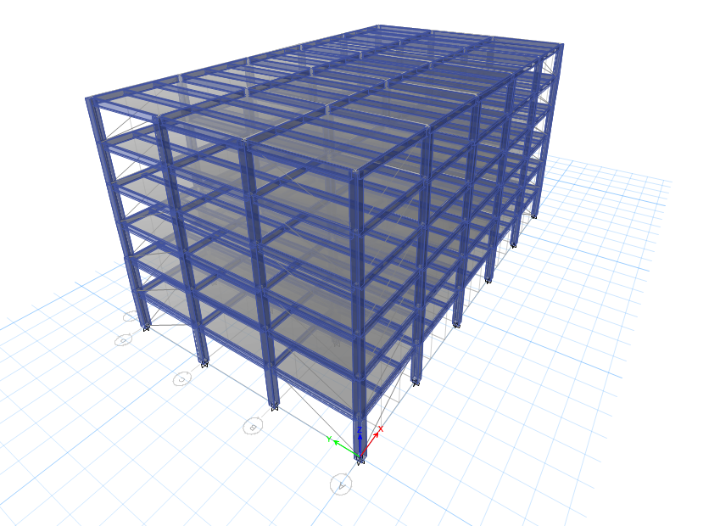
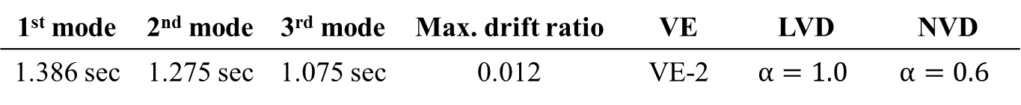
Introduction
Model information
Chia-Yi City
Type II Soil
2F~6F @ 4m
1F @ 4.5m
45m
27m
1st mode | 2nd mode | 3rd mode | Max. drift ratio | VE | LVD | NVD
1.386 sec | 1.275 sec | 1.075 sec | 0.012 | VE-2 | $$α=1.0$$ | $$α=0.6$$

Slide 3
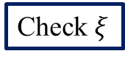
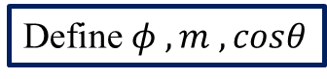
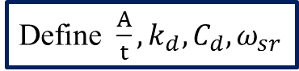
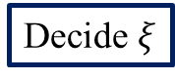
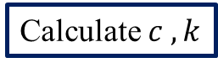
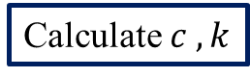
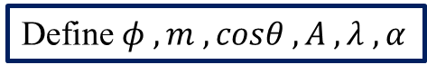
Design of dampers
Design procedure
Decide control earthquake
Preliminary design
Decide control story drift
Displacement spectrum & acceleration spectrum
Decide $ξ$
Define $φ , m , cosθ$
Define $φ , m , cosθ , A , λ , α$
Define $\frac{A}{t}, k_{d}, C_{d}, ω_{sr}$
Calculate $c , k$
Calculate $c , k$
Check $ξ$
LVD design
NVD design
VE design

Slide 4
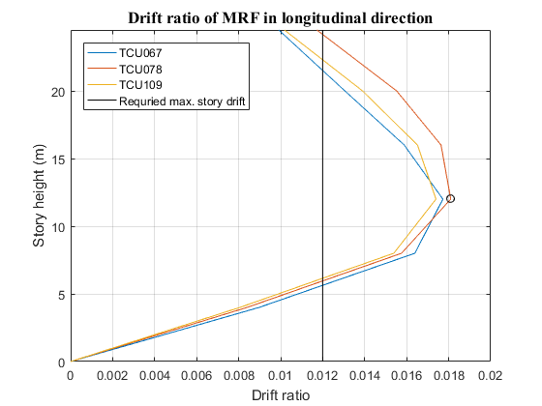
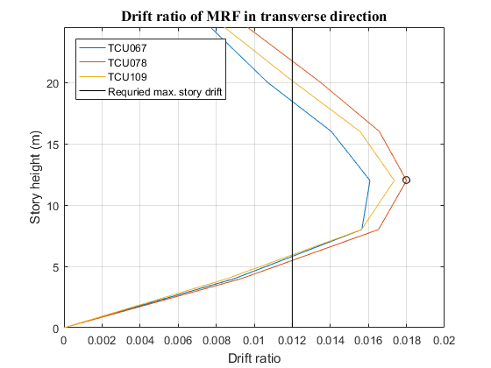
Design of dampers
Preliminary design
Decide control earthquake
Decide control story drift

Slide 5
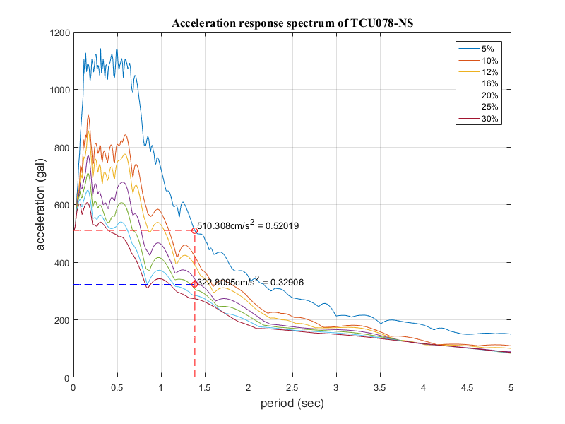
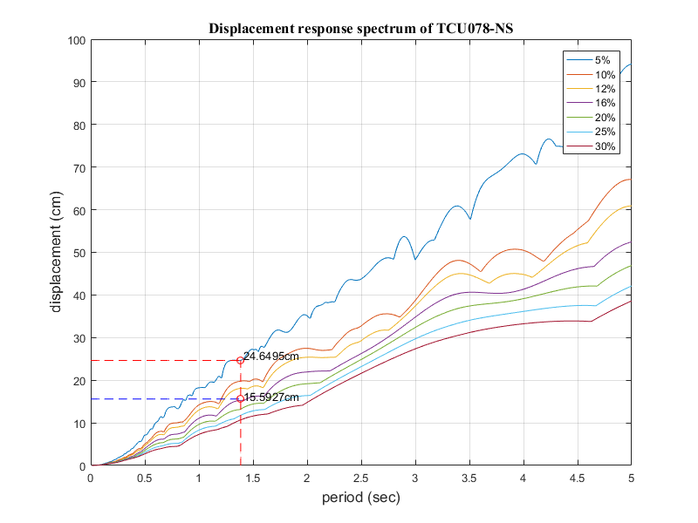
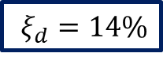
Design of dampers
Preliminary design
Displacement spectrum & acceleration spectrum
Decide $ξ$
$ξ_{d}=14\%$

Slide 6
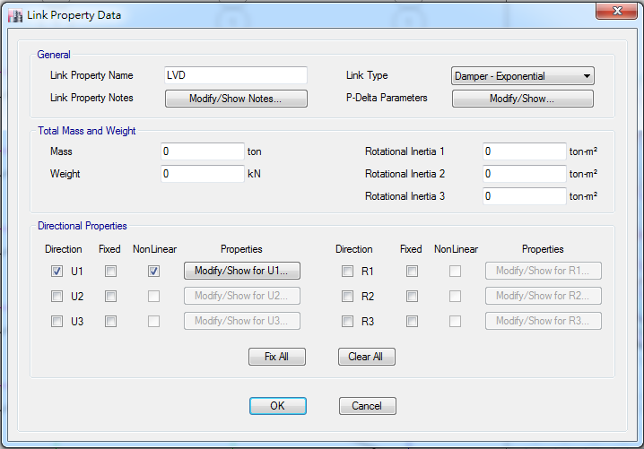
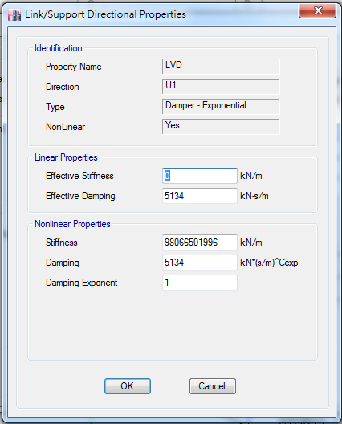
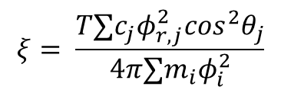
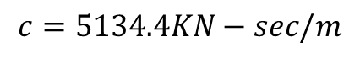
Design of dampers
Linear viscous damper design
$$ξ= \frac{T∑c_{j}φ_{r,j}^{2}cos^{2}θ_{j}}{4π∑m_{i}φ_{i}^{2}}$$
$$c=5134.4KN−sec/m$$

Slide 7
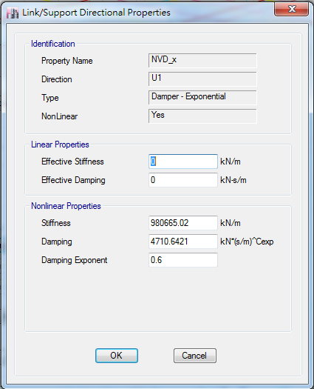

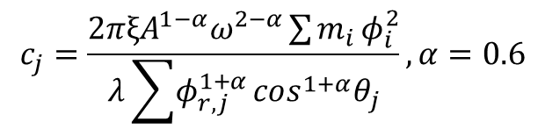
Design of dampers
Nonlinear viscous damper design
$$c_{j}=\frac{2π{ξA}^{1−α}ω^{2−α}\sum{m_{i}}φ_{i}^{2}}{λ\sum{φ_{r,j}^{1+α}}cos^{1+α}θ_{j}}, α=0.6$$
$$\left\{\begin{matrix}longitudinal direction , ξ=10\% , c=4710.64 KN−sec/m \\ transverse driection, ξ=10\% , c=5374.77 KN−sec/m\end{matrix}\right.$$

Slide 8
Design of dampers
Viscoelastic damper design

Slide 9
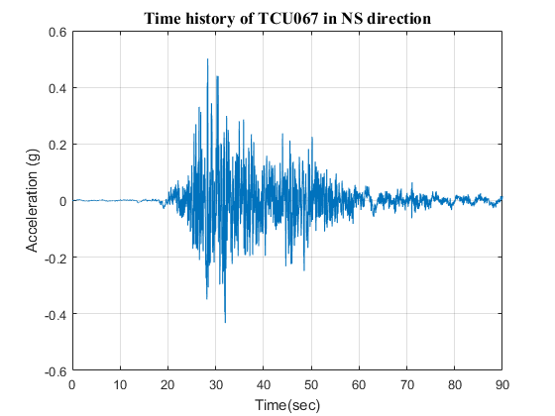
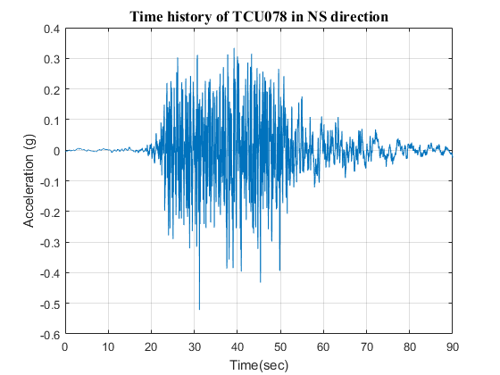
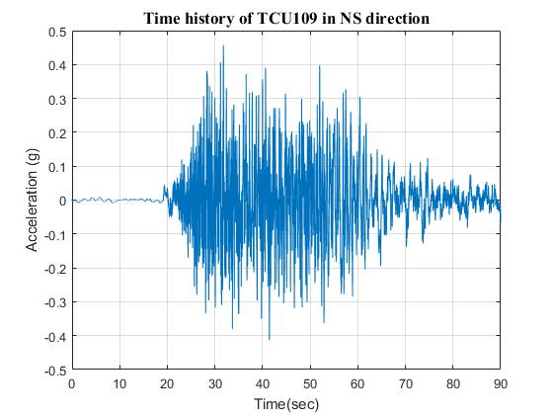
Analysis results
Design earthquake

Slide 10
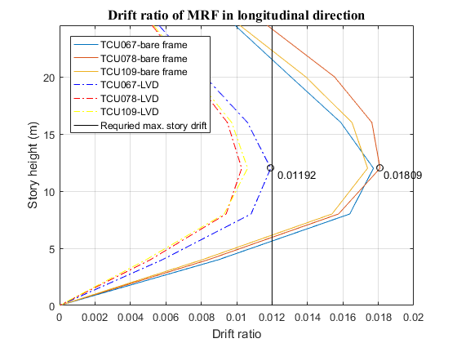
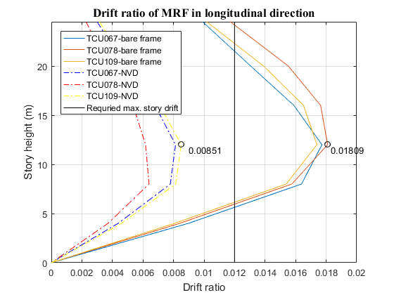
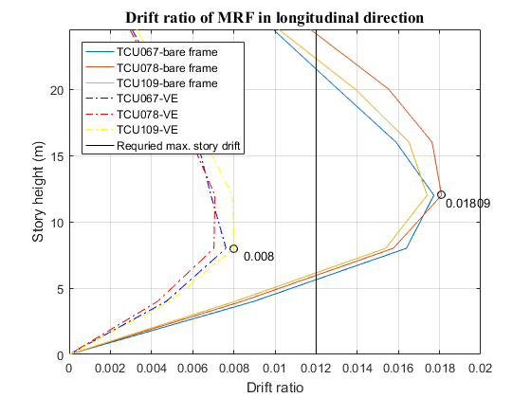
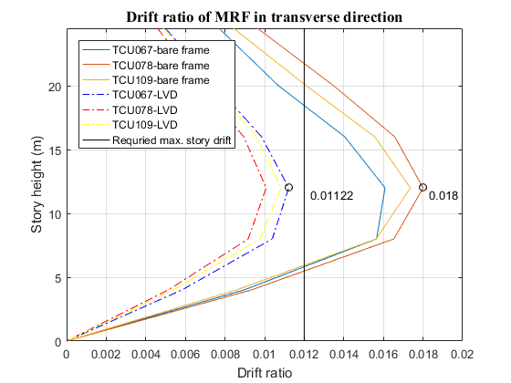
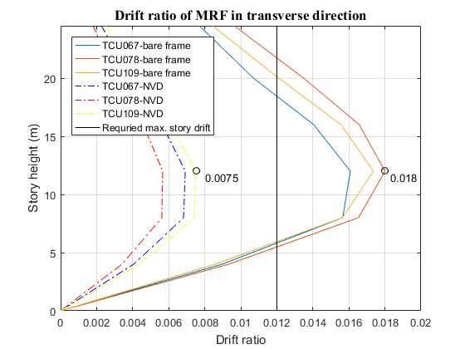
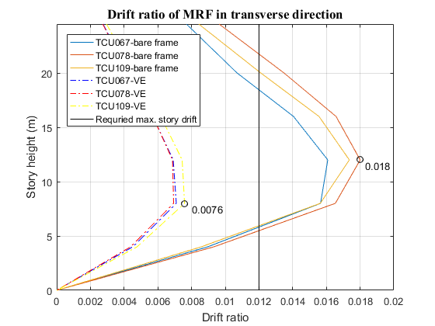
Analysis results
Story drift
X-direction
Story drift
Y-direction

Slide 11
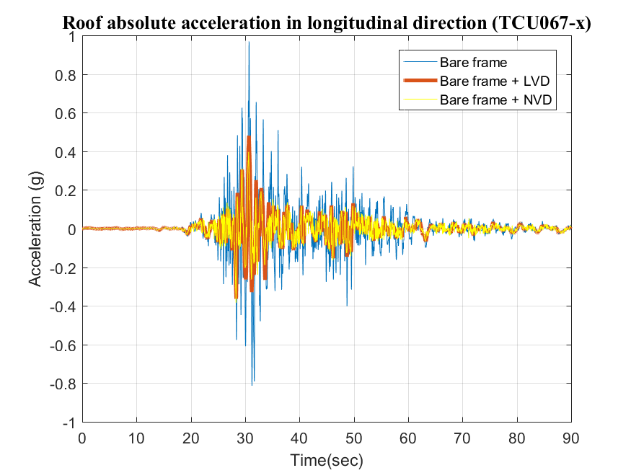
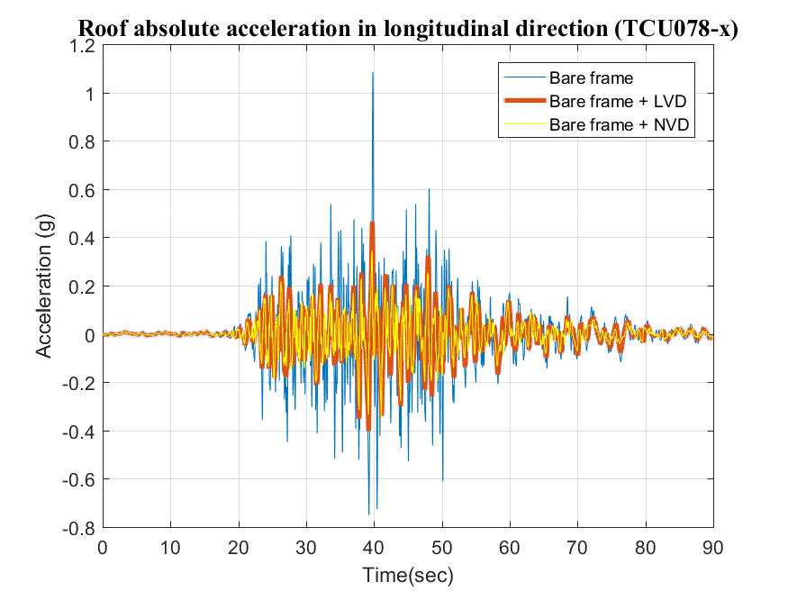
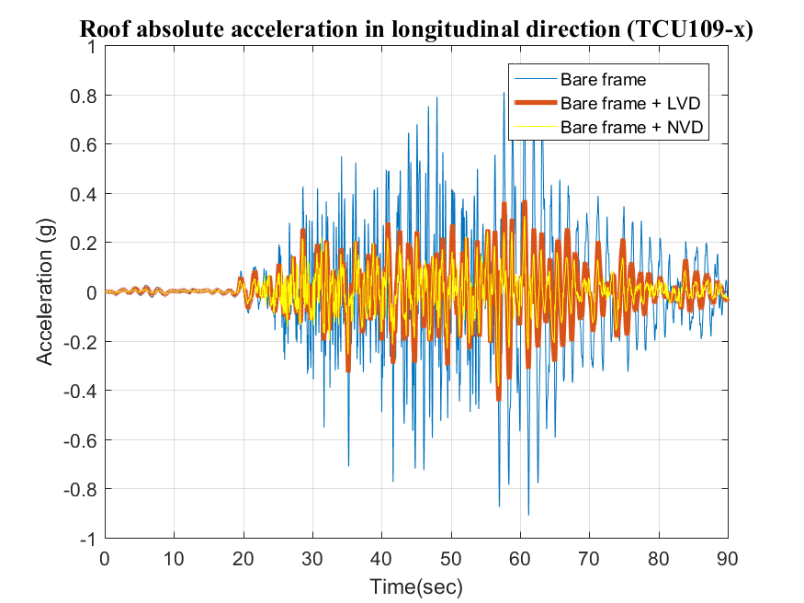
Analysis results
Roof acceleration response
X-direction
Linear VD | Relative Displacement |  | Ratio | Relative Velocity |  | Ratio | Absolute Acceleration |  | Ratio
 | Bare frame | VD | % | Bare frame | VD | % | Bare frame | VE | %
067 | 0.2700 | 0.1253 | 46.41 | 1.6367 | 1.0035 | 61.31 | 9.502 | 4.717 | 49.64
078 | 0.2662 | 0.1758 | 66.04 | 1.3923 | 0.8552 | 61.42 | 10.647 | 4.561 | 42.84
109 | 0.3214 | 0.1885 | 58.65 | 1.6144 | 0.8445 | 52.31 | 7.973 | 3.629 | 45.52
Nonlinear VD | Relative Displacement |  | Ratio | Relative Velocity |  | Ratio | Absolute Acceleration |  | Ratio
 | Bare frame | NVD | % | Bare frame | NVD | % | Bare frame | NVD | %
067 | 0.2700 | 0.1409 | 52.19 | 1.6367 | 0.6483 | 39.61 | 9.502 | 3.8886 | 40.92
078 | 0.2662 | 0.1087 | 40.83 | 1.3923 | 0.5405 | 38.82 | 10.647 | 3.4059 | 31.99
109 | 0.3214 | 0.1447 | 45.02 | 1.6144 | 0.5675 | 35.15 | 7.973 | 3.7857 | 47.48

Slide 12
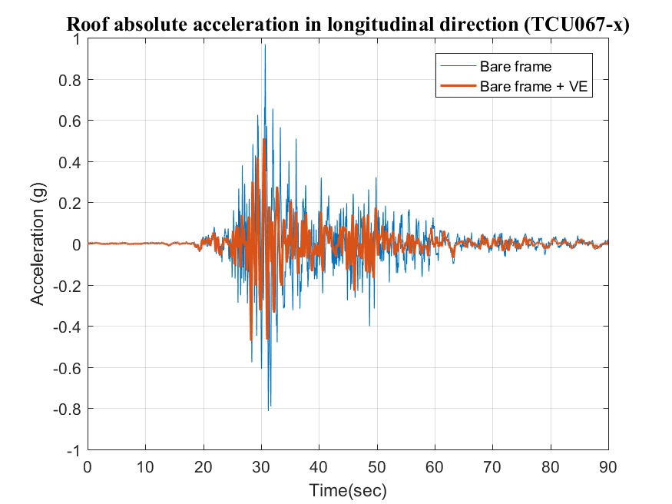
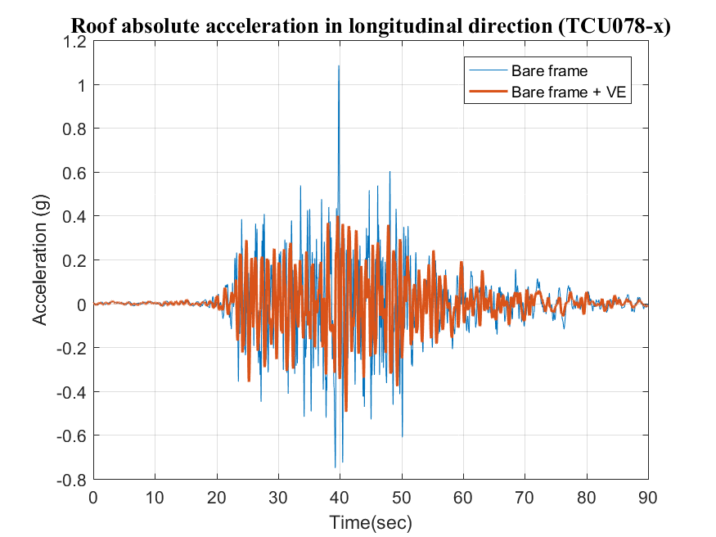
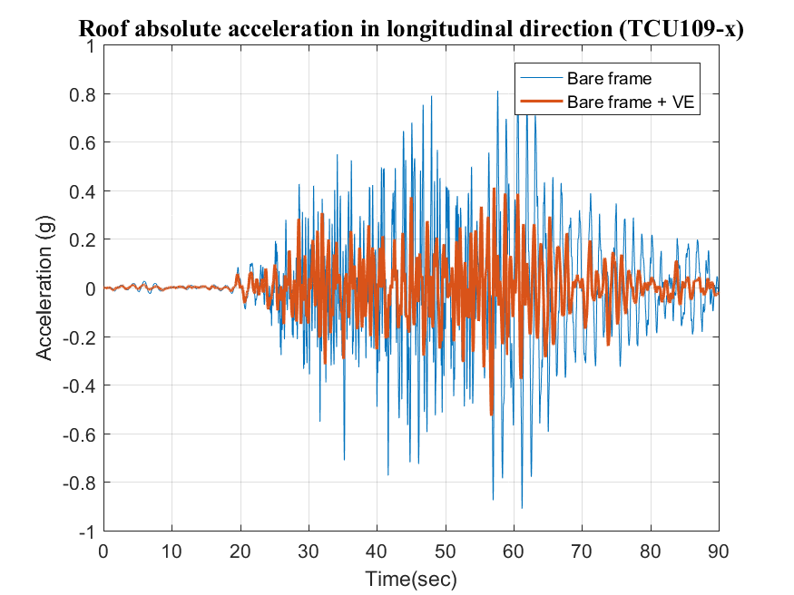
Analysis results
Roof acceleration response
X-direction
VE | Relative Displacement |  | Ratio | Relative Velocity |  | Ratio | Absolute Acceleration |  | Ratio
 | Bare frame | VE | % | Bare frame | VE | % | Bare frame | VE | %
067 | 0.2700 | 0.1367 | 50.63 | 1.6367 | 0.7831 | 47.85 | 9.502 | 5.013 | 52.76
078 | 0.2662 | 0.1274 | 47.86 | 1.3923 | 0.7224 | 51.89 | 10.647 | 4.851 | 45.56
109 | 0.3214 | 0.1444 | 44.93 | 1.6144 | 0.9575 | 59.31 | 7.973 | 5.179 | 64.96
Notes:
有效降低峰值

Slide 13
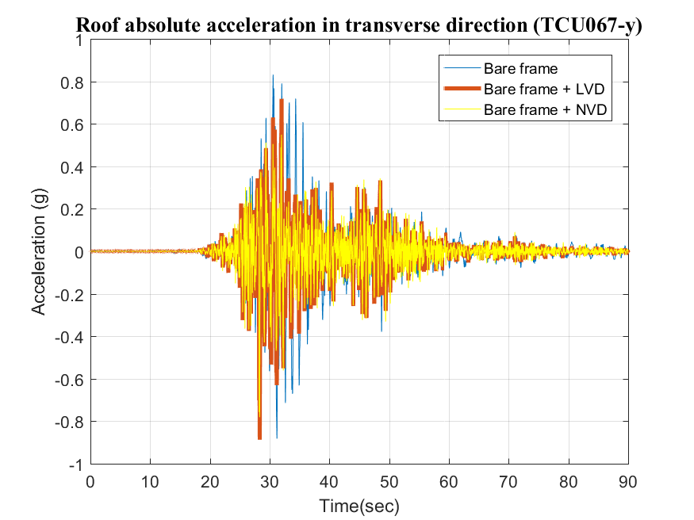
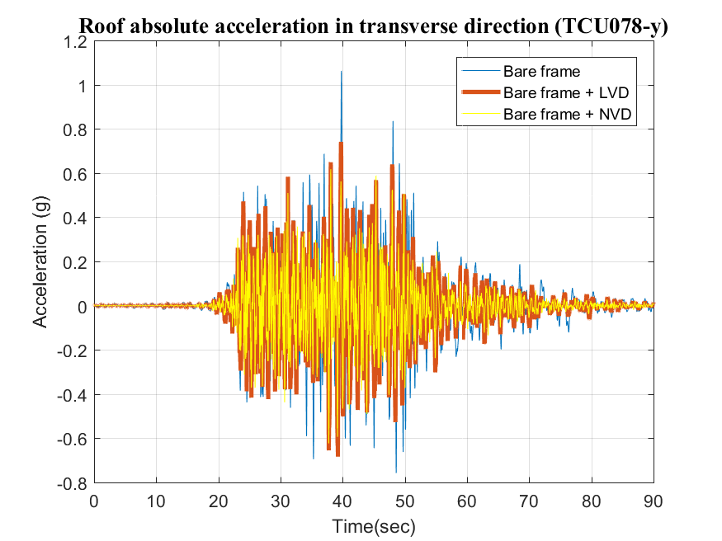
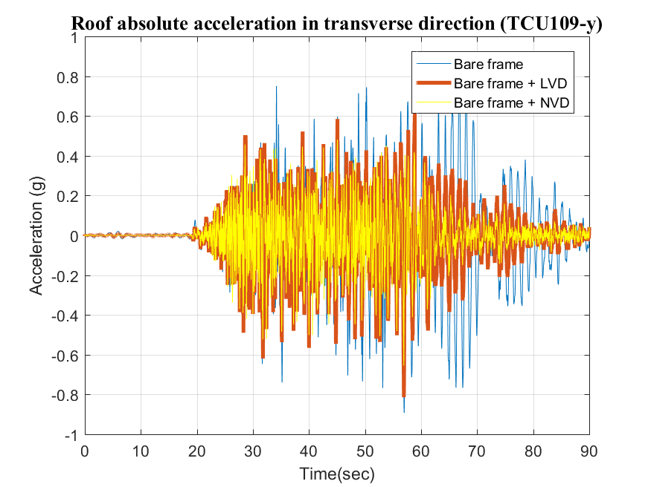
Analysis results
Roof acceleration response
Y-direction
Linear VD | Relative Displacement |  | Ratio | Relative Velocity |  | Ratio | Absolute Acceleration |  | Ratio
 | Bare frame | VD | % | Bare frame | VD | % | Bare frame | VE | %
067 | 0.2518 | 0.1263 | 50.16 | 1.7387 | 1.0438 | 60.03 | 8.161 | 7.040 | 86.26
078 | 0.2412 | 0.1483 | 61.48 | 1.6896 | 0.8049 | 47.64 | 10.426 | 7.269 | 69.72
109 | 0.2907 | 0.1911 | 65.74 | 1.6535 | 0.8736 | 52.83 | 8.818 | 6.233 | 70.68
Nonlinear VD | Relative Displacement |  | Ratio | Relative Velocity |  | Ratio | Absolute Acceleration |  | Ratio
 | Bare frame | NVD | % | Bare frame | NVD | % | Bare frame | NVD | %
067 | 0.2518 | 0.1197 | 47.54 | 1.7387 | 0.6125 | 35.23 | 8.161 | 7.6632 | 93.90
078 | 0.2412 | 0.0955 | 39.59 | 1.6896 | 0.5424 | 32.10 | 10.426 | 6.1153 | 58.65
109 | 0.2907 | 0.1282 | 44.10 | 1.6535 | 0.6119 | 37.01 | 8.818 | 6.4271 | 72.89
Notes:
有效降低峰值

Slide 14
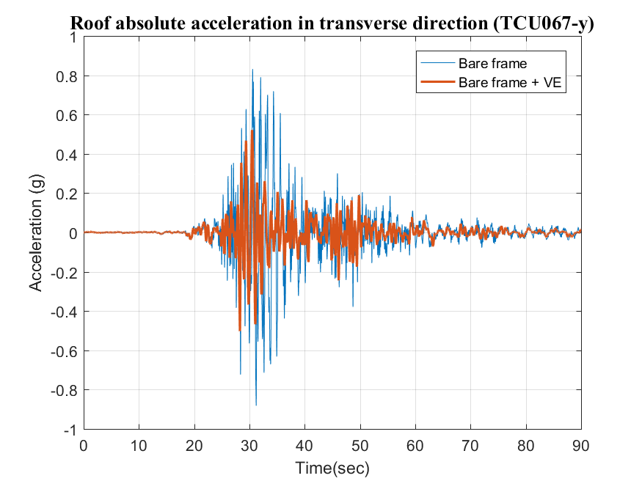
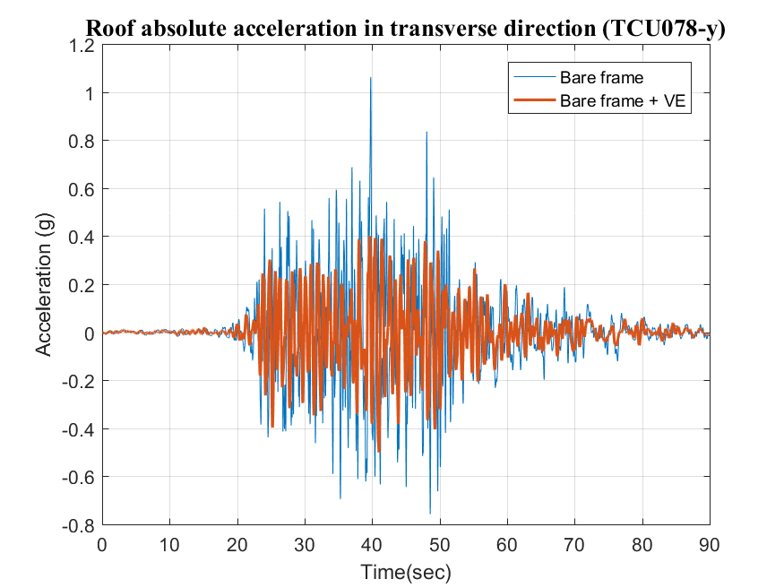
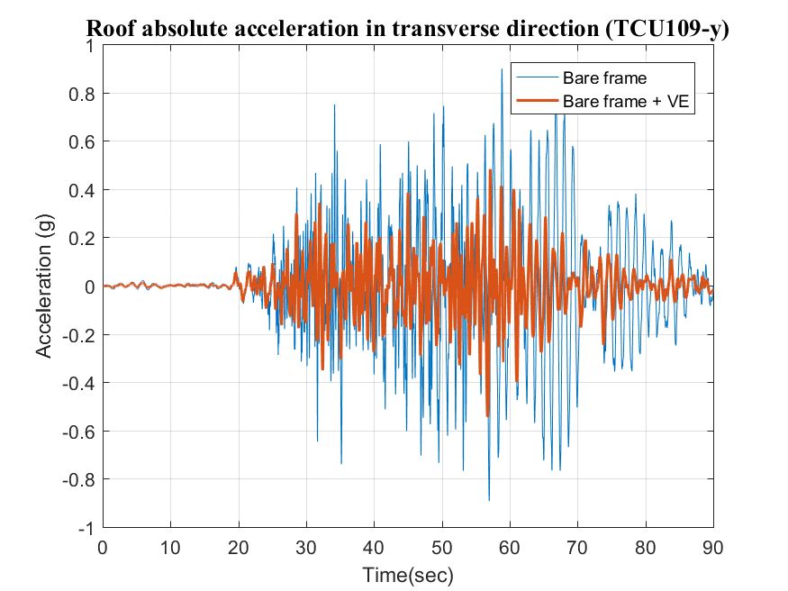
Analysis results
Roof acceleration response
Y-direction
VE | Relative Displacement |  | Ratio | Relative Velocity |  | Ratio | Absolute Acceleration |  | Ratio
 | Bare frame | VE | % | Bare frame | VE | % | Bare frame | VE | %
067 | 0.2518 | 0.1269 | 50.40 | 1.7387 | 0.835 | 48.02 | 8.161 | 5.115 | 62.68
078 | 0.2412 | 0.1239 | 51.37 | 1.6896 | 0.7295 | 43.18 | 10.426 | 4.917 | 47.16
109 | 0.2907 | 0.1363 | 46.89 | 1.6535 | 0.9738 | 58.89 | 8.818 | 5.343 | 60.59
Notes:
有效降低峰值

Slide 15
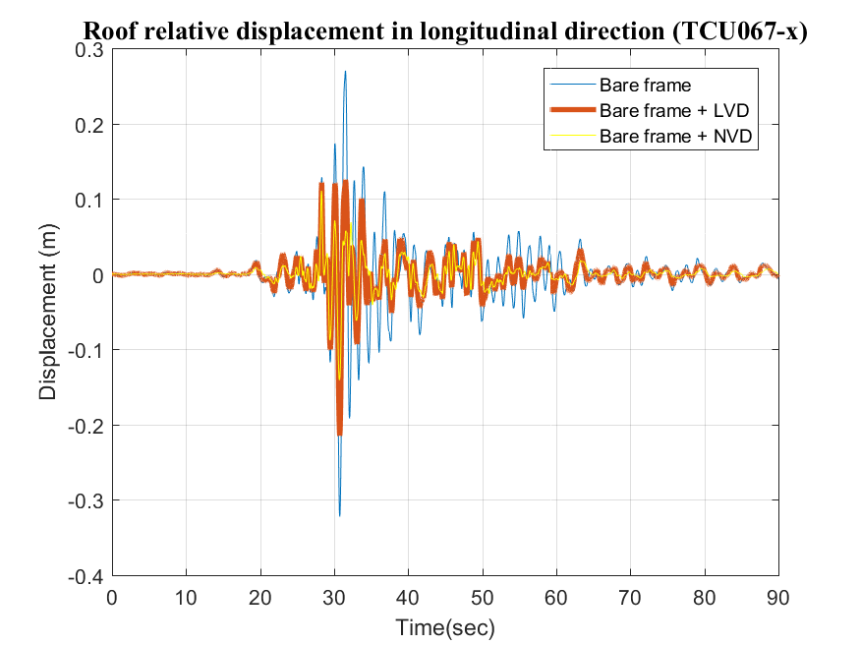
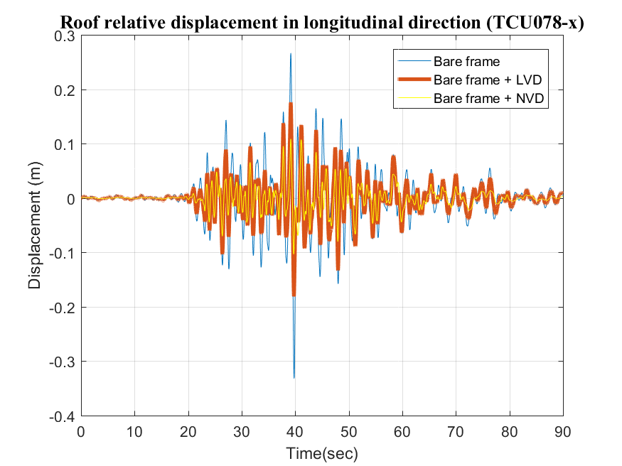
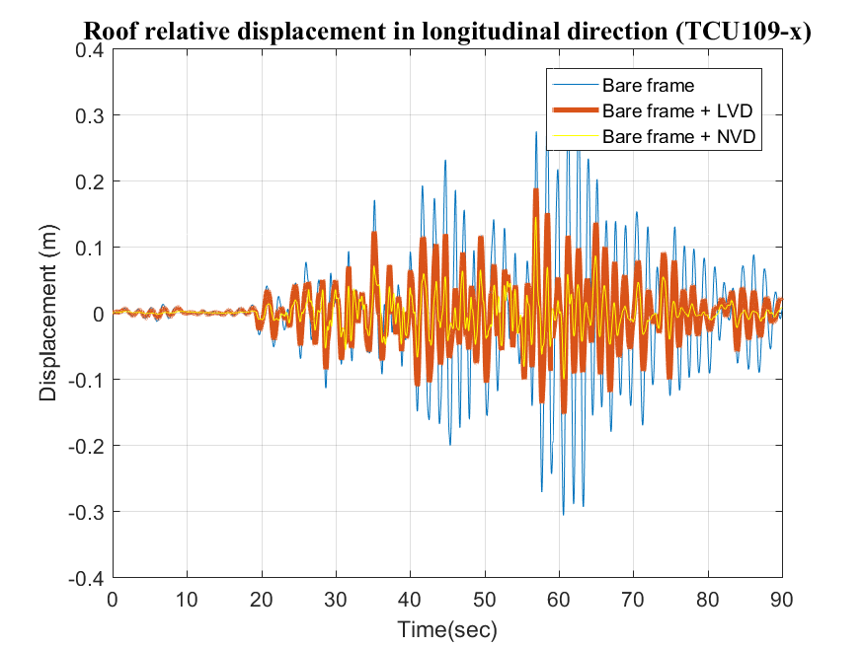
Analysis results
Roof displacement response
X-direction
Linear VD | Relative Displacement |  | Ratio | Relative Velocity |  | Ratio | Absolute Acceleration |  | Ratio
 | Bare frame | VD | % | Bare frame | VD | % | Bare frame | VE | %
067 | 0.2700 | 0.1253 | 46.41 | 1.6367 | 1.0035 | 61.31 | 9.502 | 4.717 | 49.64
078 | 0.2662 | 0.1758 | 66.04 | 1.3923 | 0.8552 | 61.42 | 10.647 | 4.561 | 42.84
109 | 0.3214 | 0.1885 | 58.65 | 1.6144 | 0.8445 | 52.31 | 7.973 | 3.629 | 45.52
Nonlinear VD | Relative Displacement |  | Ratio | Relative Velocity |  | Ratio | Absolute Acceleration |  | Ratio
 | Bare frame | NVD | % | Bare frame | NVD | % | Bare frame | NVD | %
067 | 0.2700 | 0.1409 | 52.19 | 1.6367 | 0.6483 | 39.61 | 9.502 | 3.8886 | 40.92
078 | 0.2662 | 0.1087 | 40.83 | 1.3923 | 0.5405 | 38.82 | 10.647 | 3.4059 | 31.99
109 | 0.3214 | 0.1447 | 45.02 | 1.6144 | 0.5675 | 35.15 | 7.973 | 3.7857 | 47.48

Slide 16
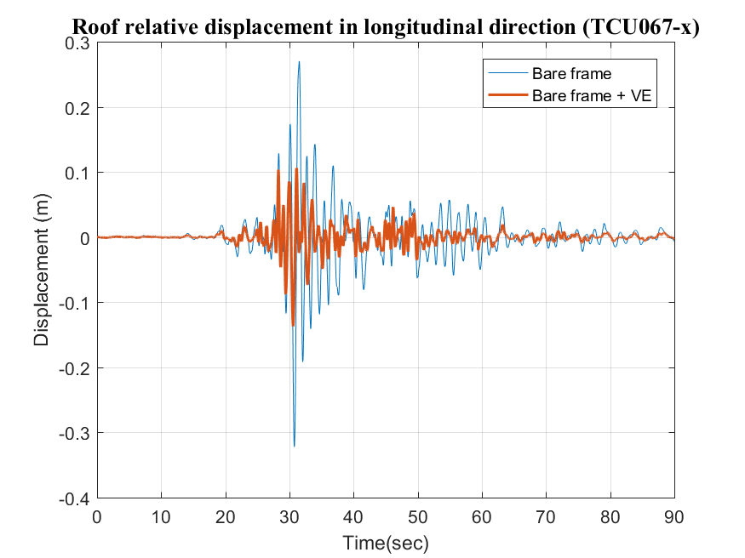
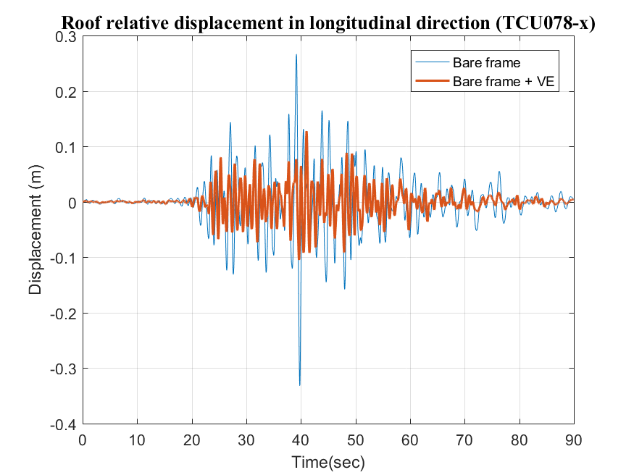
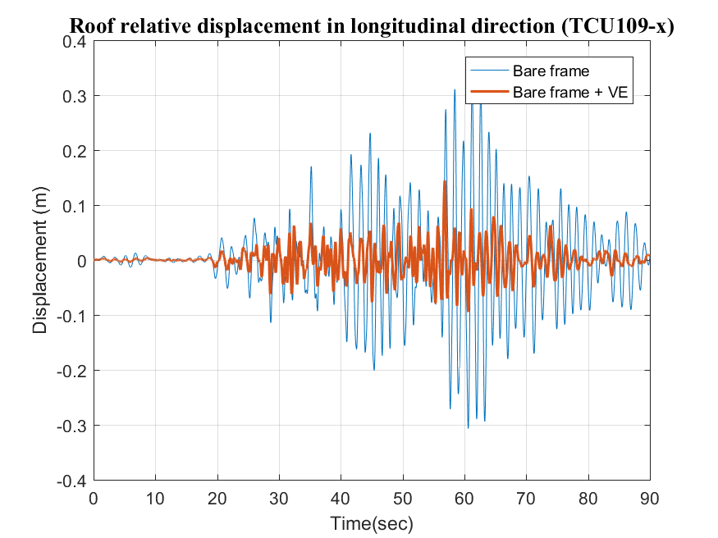
Analysis results
Roof displacement response
X-direction
VE | Relative Displacement |  | Ratio | Relative Velocity |  | Ratio | Absolute Acceleration |  | Ratio
 | Bare frame | VE | % | Bare frame | VE | % | Bare frame | VE | %
067 | 0.2700 | 0.1367 | 50.63 | 1.6367 | 0.7831 | 47.85 | 9.502 | 5.013 | 52.76
078 | 0.2662 | 0.1274 | 47.86 | 1.3923 | 0.7224 | 51.89 | 10.647 | 4.851 | 45.56
109 | 0.3214 | 0.1444 | 44.93 | 1.6144 | 0.9575 | 59.31 | 7.973 | 5.179 | 64.96

Slide 17
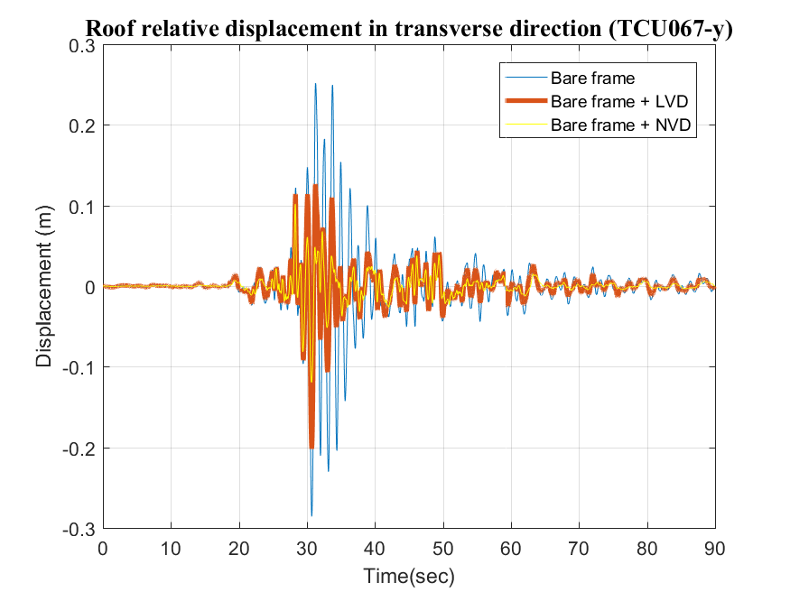
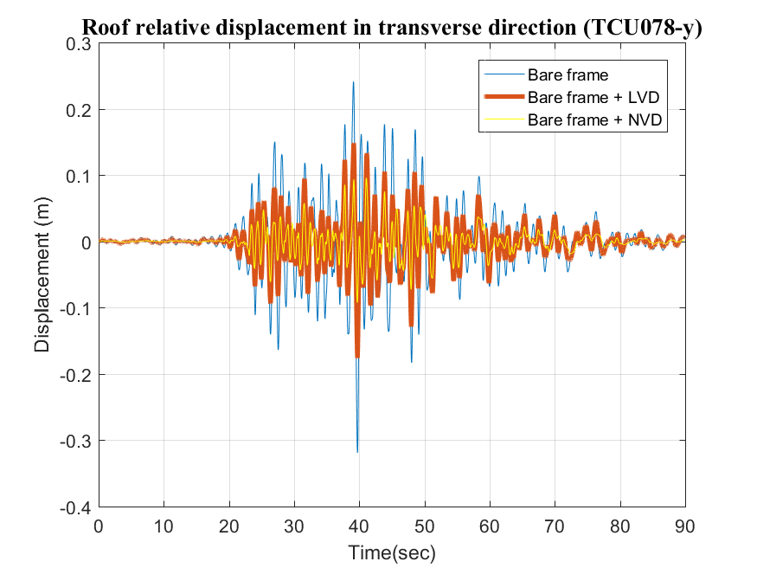
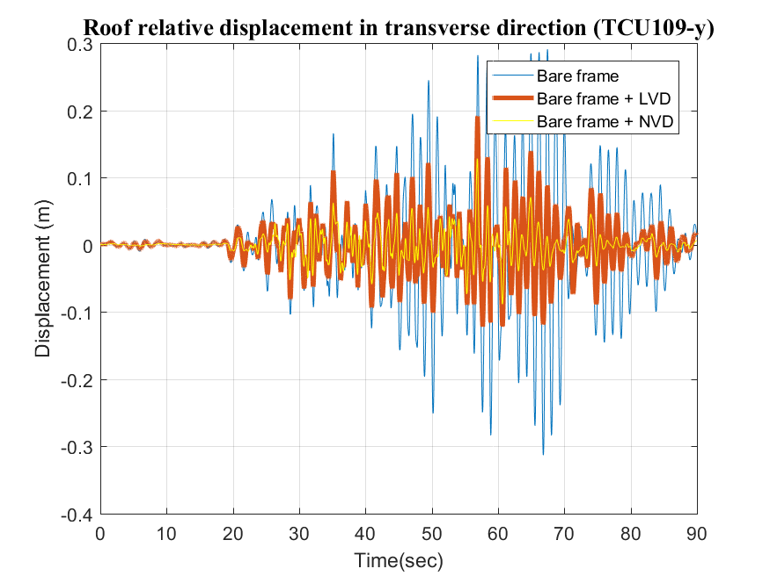
Analysis results
Roof displacement response
Y-direction
Linear VD | Relative Displacement |  | Ratio | Relative Velocity |  | Ratio | Absolute Acceleration |  | Ratio
 | Bare frame | VD | % | Bare frame | VD | % | Bare frame | VE | %
067 | 0.2518 | 0.1263 | 50.16 | 1.7387 | 1.0438 | 60.03 | 8.161 | 7.040 | 86.26
078 | 0.2412 | 0.1483 | 61.48 | 1.6896 | 0.8049 | 47.64 | 10.426 | 7.269 | 69.72
109 | 0.2907 | 0.1911 | 65.74 | 1.6535 | 0.8736 | 52.83 | 8.818 | 6.233 | 70.68
Nonlinear VD | Relative Displacement |  | Ratio | Relative Velocity |  | Ratio | Absolute Acceleration |  | Ratio
 | Bare frame | NVD | % | Bare frame | NVD | % | Bare frame | NVD | %
067 | 0.2518 | 0.1197 | 47.54 | 1.7387 | 0.6125 | 35.23 | 8.161 | 7.6632 | 93.90
078 | 0.2412 | 0.0955 | 39.59 | 1.6896 | 0.5424 | 32.10 | 10.426 | 6.1153 | 58.65
109 | 0.2907 | 0.1282 | 44.10 | 1.6535 | 0.6119 | 37.01 | 8.818 | 6.4271 | 72.89

Slide 18



Analysis results
Roof displacement response
Y-direction
VE | Relative Displacement |  | Ratio | Relative Velocity |  | Ratio | Absolute Acceleration |  | Ratio
 | Bare frame | VE | % | Bare frame | VE | % | Bare frame | VE | %
067 | 0.2518 | 0.1269 | 50.40 | 1.7387 | 0.835 | 48.02 | 8.161 | 5.115 | 62.68
078 | 0.2412 | 0.1239 | 51.37 | 1.6896 | 0.7295 | 43.18 | 10.426 | 4.917 | 47.16
109 | 0.2907 | 0.1363 | 46.89 | 1.6535 | 0.9738 | 58.89 | 8.818 | 5.343 | 60.59

Slide 19






Analysis results
Hysteresis loop
X-direction
Hysteresis loop
Y-direction

Slide 20









Analysis results
Energy dissipation
X-direction

Slide 21









Analysis results
Energy dissipation
Y-direction

Slide 22

Nonlinear Time History Analysis
Modified PISA3D model

Slide 23


Nonlinear Time History Analysis
Modified PISA3D model

Slide 24
Nonlinear Time History Analysis
Test earthquake

Slide 25
Nonlinear Time History Analysis
Story drift
X-direction

Slide 26
Nonlinear Time History Analysis

Slide 27


Design of FPS
$$K_{eff}=\frac{W}{R}+\frac{μW}{D}$$
Notes:
由於 FPS的 Keff 和重量有很大的關係，所以不能像 LRB HDRB 一樣只取平均載重做設計，比較合理的設計是分別計算每個柱底所承受的重力，在分別推出 Keff。

Slide 28














Design of FPS
$$R=4.3812m$$
$$K_{eff}=\frac{W}{R}+\frac{μW}{D}$$
$$K_{eff}=38, 74, 147tf/m$$
$$W=88, 171, 341tf$$
$$T=3s$$
$$K_{H}=\frac{W}{R}$$
$$K_{H}=20, 39, 78tf/m$$
$$B_{eff}=30\%$$
$$μ=0.05$$
$$K_{1}=51K_{H}$$
$$K_{1}=1020, 1991, 3975tf/m$$
$$D_{D}=0.2458m$$
Notes:
首先訂出我們的設計的重量、週期、xi、mu、DD 後
計算由遲滯迴圈的公式計算出 R

Slide 29




Design of FPS
$$R=4.3812m$$
$$K_{eff}=\frac{W}{R}+\frac{μW}{D}$$
$$K_{eff}=38, 74, 147tf/m$$
$$W=88, 171, 341tf$$
$$T=3s$$
$$K_{H}=\frac{W}{R}$$
$$K_{H}=20, 39, 78tf/m$$
$$B_{eff}=30\%$$
$$μ=0.05$$
$$K_{1}=51K_{H}$$
$$K_{1}=1020, 1991, 3975tf/m$$
$$D_{D}=0.2458m$$
Notes:
之後由 R 計算出 Keff

Slide 30




Design of FPS
$$R=4.3812m$$
$$K_{eff}=\frac{W}{R}+\frac{μW}{D}$$
$$K_{eff}=38, 74, 147tf/m$$
$$W=88, 171, 341tf$$
$$T=3s$$
$$K_{H}=\frac{W}{R}$$
$$K_{H}=20, 39, 78tf/m$$
$$B_{eff}=30\%$$
$$μ=0.05$$
$$K_{1}=51K_{H}$$
$$K_{1}=1020, 1991, 3975tf/m$$
$$D_{D}=0.2458m$$
Notes:
然後可以計算出遲滯迴圈的水平斜率

Slide 31



Design of FPS
$$R=4.3812m$$
$$K_{eff}=\frac{W}{R}+\frac{μW}{D}$$
$$K_{eff}=38, 74, 147tf/m$$
$$W=88, 171, 341tf$$
$$T=3s$$
$$K_{H}=\frac{W}{R}$$
$$K_{H}=20, 39, 78tf/m$$
$$B_{eff}=30\%$$
$$μ=0.05$$
$$K_{1}=51K_{H}$$
$$K_{1}=1020, 1991, 3975tf/m$$
$$D_{D}=0.2458m$$
Notes:
最後是 K1，FPS 應該要是接近於垂直，但是 ETABS 無法給無限大，所以我們以經驗公式 51KH 得到 K1，一個很大的值

Slide 32















Design of FPS
$$R=4.3812m$$
$$W=88, 171, 341tf$$
$$K_{eff}=38, 74, 147tf/m$$
$$B_{eff}=30\%$$
$$K_{H}=20, 39, 78tf/m$$
$$μ=0.05$$
$$K_{1}=1020, 1991, 3975tf/m$$
$$D_{D}=0.2458m$$
$$T=2π\sqrt{\frac{W}{K_{eff}g}}$$
$T=3.0533$s
$T=3s$?
$$T=2π\sqrt{\frac{R}{g}}$$
$$T=4.1990s$$
$T=3.054$s
Notes:
但不知道大家有沒有發現，我們從頭到尾都沒有用到 T = 3秒這個已知數
後來我們回去驗證，發現 T 的確和我們設計得差不多。並且進 ETABS 以單自由度進行驗證。

Slide 33





Design of FPS
$$R=4.3812m$$
$$W=88, 171, 341tf$$
$$K_{eff}=38, 74, 147tf/m$$
$$B_{eff}=30\%$$
$$K_{H}=20, 39, 78tf/m$$
$$μ=0.05$$
$$K_{1}=1020, 1991, 3975tf/m$$
$$D_{D}=0.2458m$$
$$T=2π\sqrt{\frac{W}{K_{eff}g}}$$
$T=3.0533$s
$T=3s$?
$$T=2π\sqrt{\frac{R}{g}}$$
$$T=4.1990s$$
$T=3.054$s
Notes:
但其實是後來 try and error 調整 mu 造成週期變才決定的 mu 值，所以才會看起來這麼剛好。

Slide 34



Design of FPS
$$R=4.3812m$$
$$W=88, 171, 341tf$$
$$K_{eff}=38, 74, 147tf/m$$
$$B_{eff}=30\%$$
$$K_{H}=20, 39, 78tf/m$$
$$μ=0.05$$
$$K_{1}=1020, 1991, 3975tf/m$$
$$D_{D}=0.2458m$$
$$T=2π\sqrt{\frac{W}{K_{eff}g}}$$
$T=3.0533$s
$T=3s$?
$$T=2π\sqrt{\frac{R}{g}}$$
$$T=4.1990s$$
$T=3.054$s
Notes:
但是摩擦係數應該是廠商提供的，而不應該是結構物的週期決定了摩擦係數。
後來才發現由於是我們設計位移一開始就選定了，所以才造成摩擦係數被週期綁死的現象。

Slide 35


Design of FPS
$$R=4.3812m$$
$$W=88, 171, 341tf$$
$$K_{eff}=38, 74, 147tf/m$$
$$B_{eff}=30\%$$
$$K_{H}=20, 39, 78tf/m$$
$$μ=0.05$$
$$K_{1}=1020, 1991, 3975tf/m$$
$$D_{D}=0.2458m$$
$$T=2π\sqrt{\frac{W}{K_{eff}g}}$$
$T=3.0533$s
$T=3s$?
$$T=2π\sqrt{\frac{R}{g}}$$
$$T=4.1990s$$
$T=3.054$s
Notes:
可是我們發現，最開始推導 FPS 就是週期只和曲率半徑有關，就算再加上摩擦力的影響應該也不會差太多，所以拿 T =2pi根號R/g 驗證，卻發現算出來的週期差很多，這是我們目前還沒想通的問題。

Slide 36

FPS Analysis
edge1
center
corner
edge2
Notes:
接下來是關於 FPS 遲滯迴圈蠻特別的現象
就是當地震力是 X 向的時候，corner 和 edge1 的遲滯迴圈會有波動產生，一開始以為是另外一個方向所造成的原因，但是把 shear33 拿出來看卻發現每個其實都有同樣的波動，而且其實都很小。
所以應該不是因為另外一個方向的原因。

Slide 37
FPS Analysis
Geometric Noise
Notes:
如果我們再來看 Y 向的地震，會發現面對 Y 向的外側的遲滯迴圈也會產生波動。
所以我們推斷這是幾何原因所造成的。但是為甚麼外側的 FPS，會產生波動，而不向中心的 FPS 平滑，這還找不出原因。

